Slide 1
An Analysis of U.S. YouTube Trending Videos
Arina Mokeeva

Slide 2
Purpose of the Data Analysis
Purpose:
To understand what makes YouTube videos trend in the United States.
Goals:
Explore how engagement metrics like views, likes, and comments affect visibility.
Study how video categories, tags, and upload times play a role.
Find patterns that explain why certain videos gain attention faster.
Tools:
Python (Pandas, NumPy, Matplotlib, Seaborn)

Slide 3
Data Set Description
Dataset:
USvideos.csv from Kaggle: Trending YouTube Video Statistics
Description:
Contains 40,949 rows and 16 columns
15,000 random rows will be used for faster processing
Focused on the US trending videos from 2017-2018
Data collected through the YouTube Data API
Column Names:
Video ID, trending date, title, channel title, category ID, publish time, tags, views, likes, dislikes, comment count, thumbnail link, comments disabled, ratings disabled, video error or removed, and description.

Slide 4
About the Data
Structure:
8 string columns, 5 numeric columns, 3 Boolean columns
570 missing descriptions in total
193 missing descriptions in the 15,000-row dataset used for analysis
Dates were converted to standard daytime format
Focus Areas:
Relationship between views, likes, and comments
Top-performing video categories
Impact of upload time and tags on trending

Slide 5
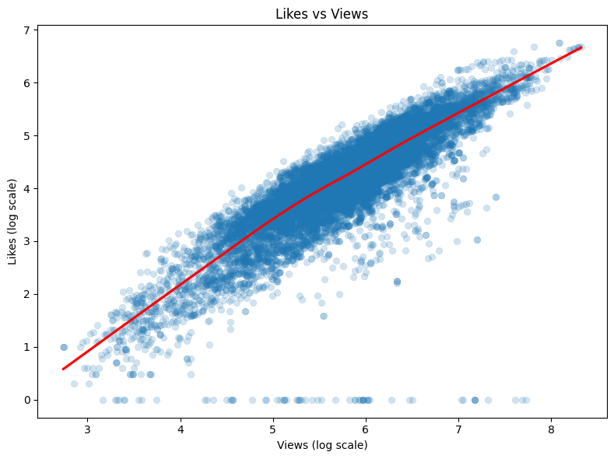
Visualization 1: Scatter Plot
A scatter plot was used to examine the relationship between a video's popularity (Views) and audience response (Likes).
The primary trend shows that videos with higher views generally receive more likes, confirming a positive correlation between attention and engagement.
A logarithmic scale was applied to both axes to visualize the entire dataset without clustering, due to the extreme range of values.
Key Findings: Outliers included videos with high views but low likes (watched but not engaged) and low views but high likes (smaller, highly active audiences), showing varying engagement patterns.

Slide 6
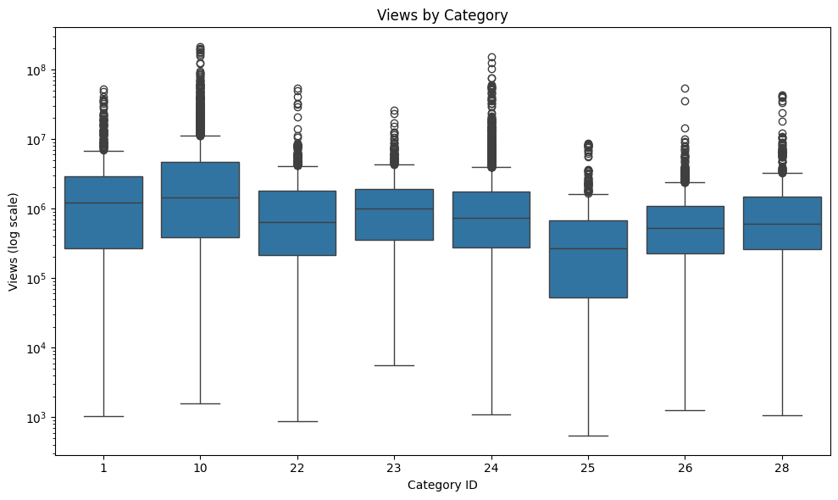
Visualization 2: Box Plot
A box plot compared the distribution of video views across different categories, also using a logarithmic scale.
Categories show distinct differences, with some groups consistently achieving higher median views than others.
Performance is highly inconsistent. Even categories with lower median views frequently produced extreme outliers (viral videos).
Key Findings: Even videos in less popular categories can become massively viral.

Slide 7
Model 1: Linear Regression
Purpose: To predict the time (in days) it takes for a video to appear on the trending list after publishing.
Target Variable: Time-to-Trend (Calculated as trending_date - publish_time).
Tested all available features, including numerical engagement metrics and categorical variables.
Result: The model determined that the category was the most influential variable, with engagement metrics having a negligible effect on trending speed.

Slide 8
Model 2: Random Forrest Classifier
Purpose: To predict whether a video will become highly viral.
Data Preparation: The target variable Virality was created by categorizing the top 10% of videos by view count as viral (1) and the rest as not viral (0).
Process: The Random Forest algorithm was trained to learn the decision rules for classifying videos into these two classes.
Result: The model achieved high accuracy (88.1%) and identified engagement metrics (views, likes, dislikes, comments) as the primary drivers of long-term virality.

Slide 9
Model 3: K-Means Clustering
Purpose: To identify natural groupings or segments of audience behavior within the trending videos.
Data Preparation: Used only the key audience engagement metrics: views, likes, dislikes, and comment count.
Clustering: The Elbow Method was used to determine the optimal number of groups (k=4).
Grouping: The algorithm partitioned the videos into four clusters based on the similarity of their engagement features.
Result: This revealed that both positive success (Likes) and highly active, polarizing content (Dislikes + Comments) are pathways to trending success.

Slide 10
Findings
Speed to trend, reaching the list quickly, is dictated by the video category.
Virality, becoming a top 10% video, is dictated by audience engagement metrics.
Categories like News & Politics, Nonprofits & Activism, and Travel & Events trend significantly faster than others.
The Random Forest model proved that the volume of views, likes, and comments are the most important features in classifying a video as truly viral.
K-Means Cluster 3 was characterized by the highest average dislikes and the highest comment volume.
Highly polarizing content generates intense discussion and reaction. The algorithm promotes this active engagement, confirming that content success is not limited to universally positive sentiment.

Slide 11
Action Steps Based on Findings
To create a trending video fast, choose fast-moving categories like News and Politics for quick trending, but rely on strong engagement for long-term virality.
Focus on video design and description to maximize user feedback such as likes, dislikes, and comments, since this drives the most algorithmic promotion.
Know that highly polarizing topics create large discussion. Use this strategy where appropriate, as controversy leads to the highest engagement cluster.
For videos in lower-average view categories, invest disproportionately in marketing and initial interaction to achieve viral outlier status.
Conduct future analysis to identify the optimal publish times and specific sub-topics within the fastest-trending categories to gain a strategic advantage.

Slide 12
Lessons Learned
The most time-consuming and critical task was converting raw date and time columns into standardized datetime formats to accurately calculate time-to-trend. This was essential before any time-series analysis could begin.
The extreme right-skewness of engagement data, with viral outliers, meant standard visualizations were ineffective. Using a logarithmic scale was necessary to reveal true patterns and differences between categories that would have otherwise been hidden.
The raw tags column, containing pipe separators and special characters, required specific string manipulation techniques to clean and extract usable features. This underscored the importance of text cleaning when working with social media data.
The analysis confirmed that success is not limited to universally positive interaction. The discovery of a highly engaged, controversial audience segment (high dislikes/comments) demonstrated that high interaction, regardless of sentiment, drives algorithmic promotion.

Slide 13
References
Abdullah, S., & Eid, H. F. (2023). Utilizing random forest algorithm for early detection of academic underperformance in open learning environments. PeerJ, 9, e1708–e1708. https://doi.org/10.7717/peerj-cs.1708
Arvai, K. (2020). K-Means Clustering in Python: A Practical Guide. Realpython.com. https://realpython.com/k-means-clustering-python/
Belcic, I. (2024, October 15). Classification in Machine Learning. Ibm.com. https://www.ibm.com/think/topics/classification-machine-learning
Faverio, M., & Sidoti, O. (2024, December 12). Teens, Social Media and Technology 2024. Pew Research Center; Pew Research Center. https://www.pewresearch.org/internet/2024/12/12/teens-social-media-and-technology-2024/
Hu, K. (2020). Become Competent within One Day in Generating Boxplots and Violin Plots for a Novice without Prior R Experience. Methods and Protocols, 3(4). https://doi.org/10.3390/mps3040064
IBM. (2021, August 18). Linear Regression. Ibm.com; IBM. https://www.ibm.com/think/topics/linear-regression
J, M. (2017). Trending YouTube Video Statistics. Kaggle.com. https://www.kaggle.com/datasets/datasnaek/youtube-new?resource=download&select=USvideos.csv
Kavlakoglu, E., & Winland, V. (2024, June 26). What is k-means clustering? IBM. https://www.ibm.com/think/topics/k-means-clustering

Slide 14
Oh, M., Maeng, K., & Shin, J. (2025). Which Factors Affect Online Video Views and Subscriptions? Reference-Dependent Consumer Preferences in the Social Media Market. Journal of Theoretical and Applied Electronic Commerce Research, 20(3), 197–197. https://doi.org/10.3390/jtaer20030197
Pan, Q., Agarwal, S., Nissim, N., & Sabut, S. K. (2025). Random Forest Classifier - an overview | ScienceDirect Topics. Www.sciencedirect.com. https://www.sciencedirect.com/topics/computer-science/random-forest-classifier
Rensink, R. A. (2017). The nature of correlation perception in scatterplots. Psychonomic Bulletin & Review, 24(3), 776–797. https://doi.org/10.3758/s13423-016-1174-7
Roustaei, N. (2024). Application and interpretation of linear-regression analysis. Medical Hypothesis Discovery & Innovation in Ophthalmology, 13(3), 151–159. https://pmc.ncbi.nlm.nih.gov/articles/PMC11537238/
Stojiljković, M. (2019, April 15). Linear Regression in Python. Realpython.com; Real Python. https://realpython.com/linear-regression-in-python/
Yang, S., Brossard, D., Scheufele, D. A., & Xenos, M. A. (2022). The science of YouTube: What factors influence user engagement with online science videos? Plos One, 17(5). https://doi.org/10.1371/journal.pone.0267697
Zubair, Md., Iqbal, MD. A., Shil, A., Chowdhury, M. J. M., Moni, M. A., & Sarker, I. H. (2022). An Improved K-means Clustering Algorithm Towards an Efficient Data-Driven Modeling. Annals of Data Science. https://doi.org/10.1007/s40745-022-00428-2

